Slide 1
Understanding Confusion Matrix

Slide 2
Measuring Performance
Classification accuracy: What % of messages were classified correctly?
Is this what we care about?
 | Overall accuracy | Accuracy on spam | Accuracy on gen
System 1 | 95% | 99.99% | 90%
System 2 | 95% | 90% | 99.99%
Which system do you prefer?
2

Slide 3
Measuring Performance
Precision = good messages kept all messages kept
Recall = good messages kept all good messages

Slide 4
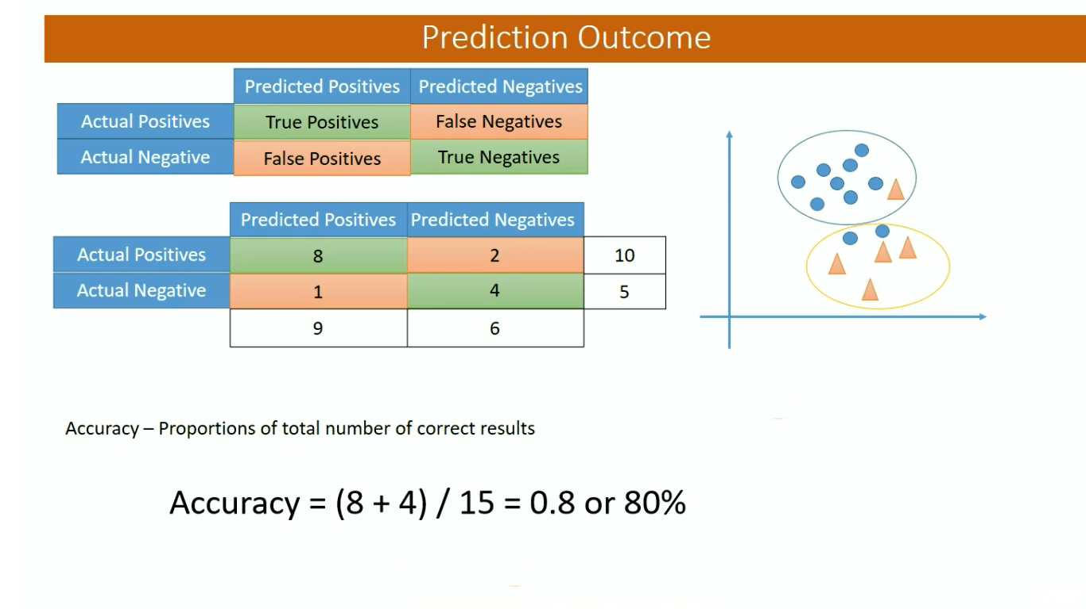
Accuracy: Overall, how often is the classifier correct?

Slide 5
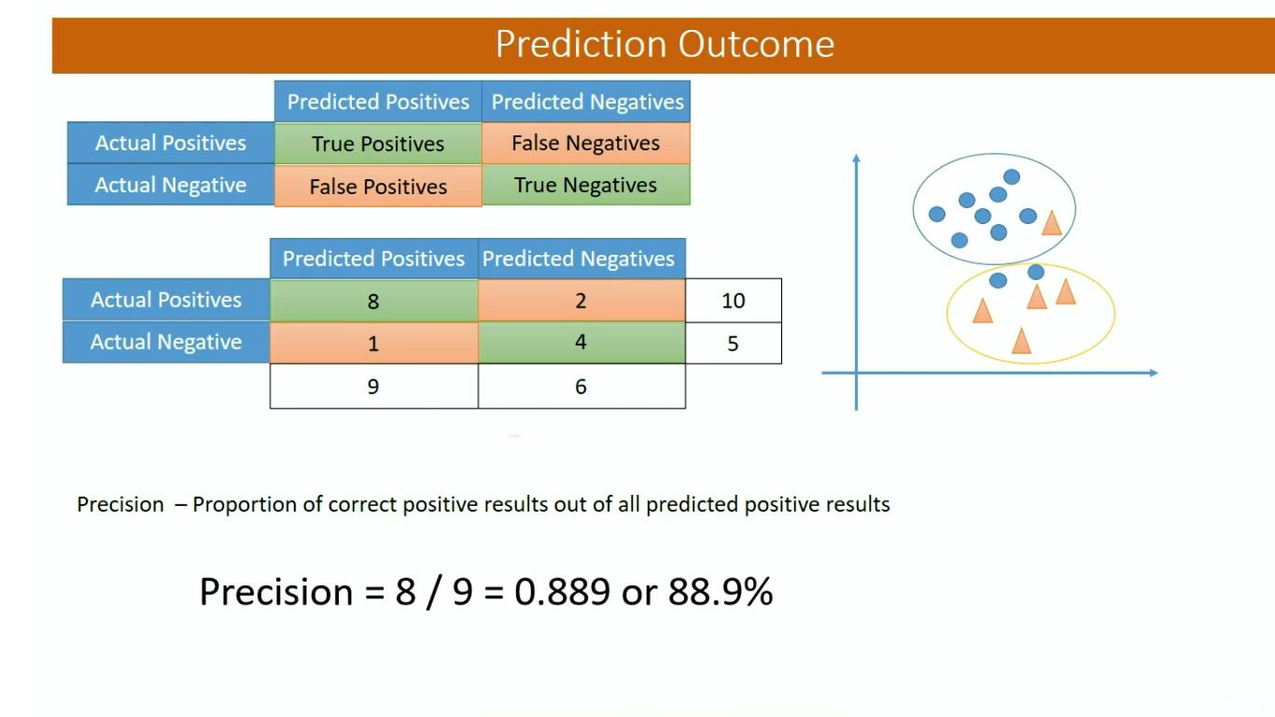
Precision: When it predicts yes, how often is it correct?

Slide 6
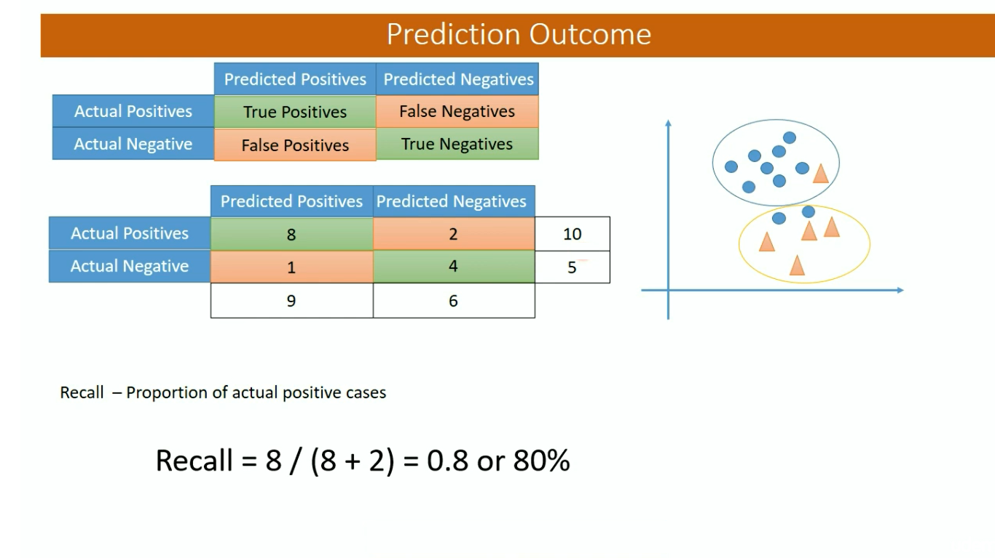
True Positive Rate: When it's actually yes, how often does it predict yes?
also known as "Sensitivity" or "Recall"

Slide 7
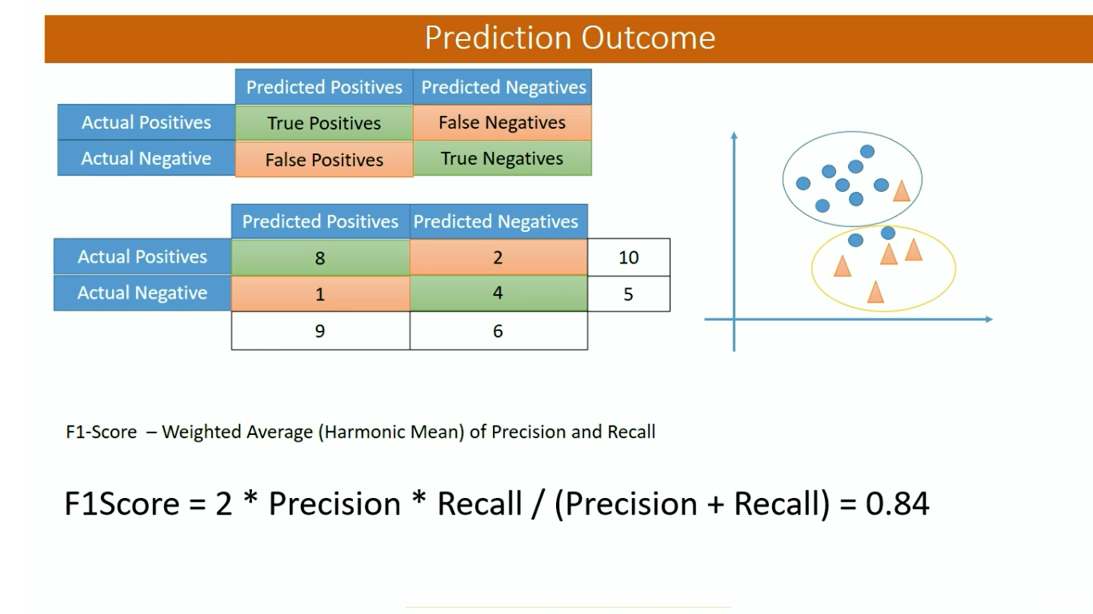

Slide 8
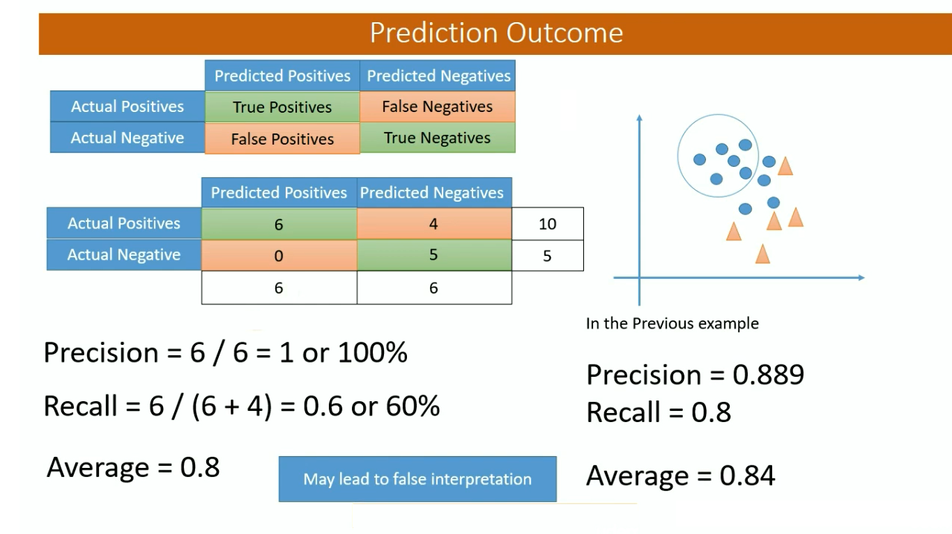

Slide 9
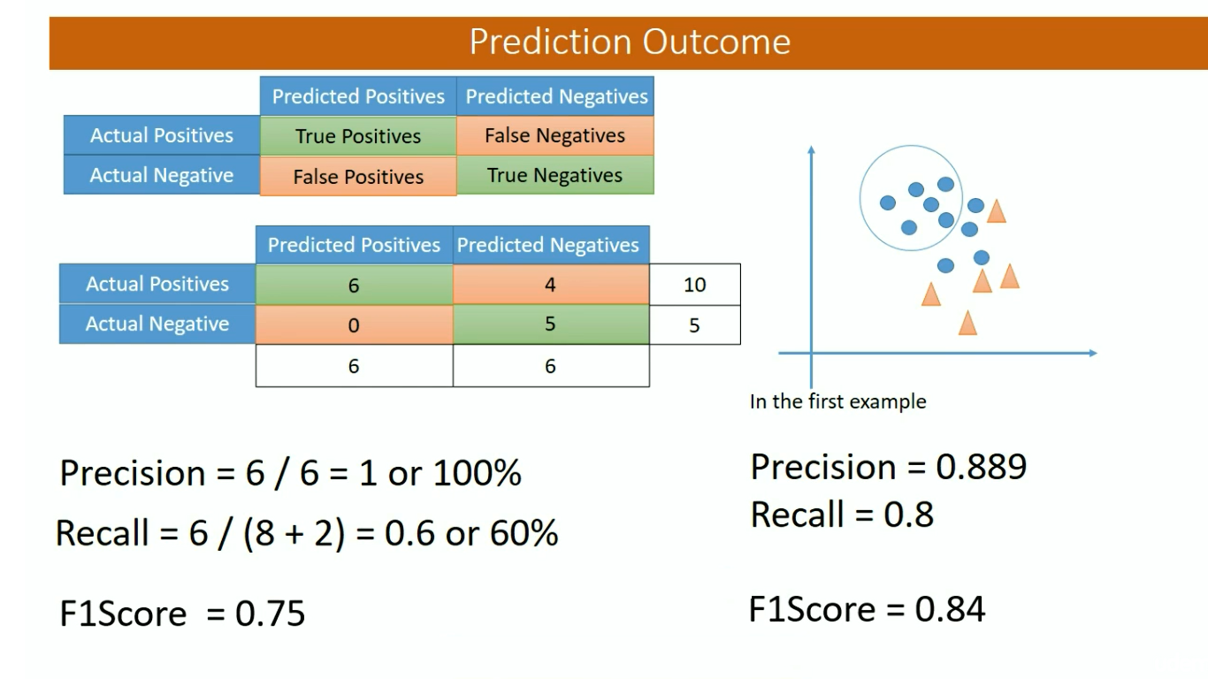

Slide 10
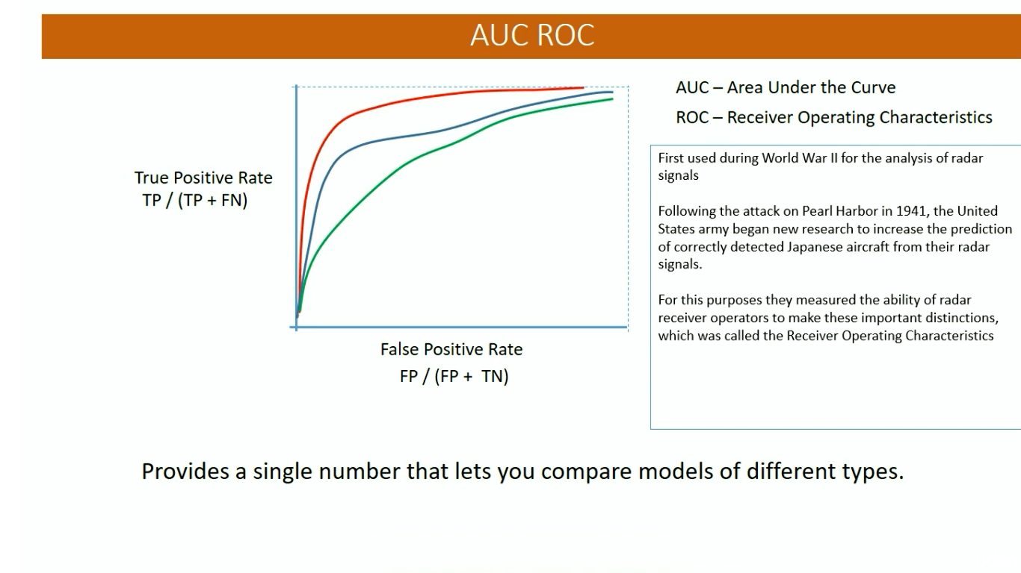

Slide 11
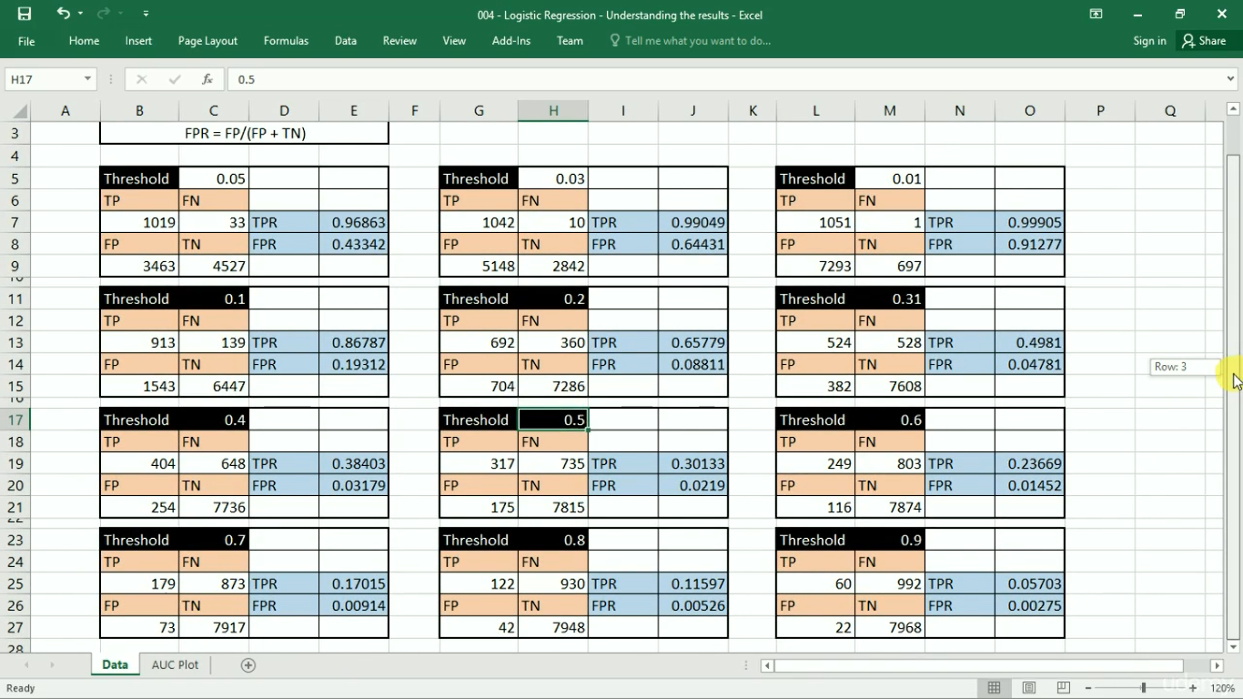

Slide 12
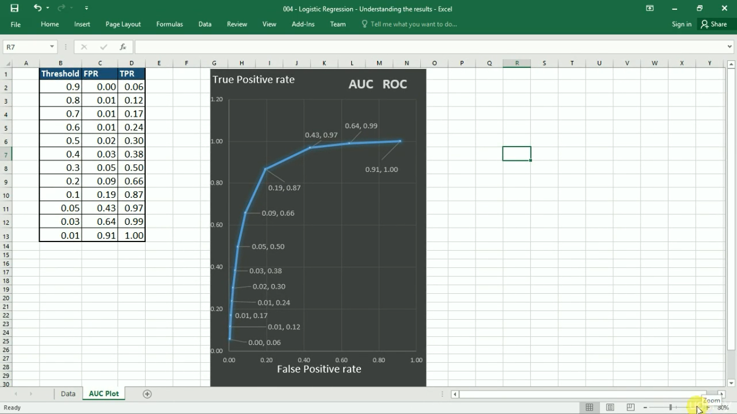

Slide 13
Understanding NLP

Slide 14
Brief history
1950s
Early MT: word translation + re-ordering
Chomsky’s Generative grammar
Bar-Hill’s argument
1960-80s
Applications
BASEBALL: use NL interface to search in a database on baseball games
LUNAR: NL interface to search in Lunar
ELIZA: simulation of conversation with a psychoanalyst
SHREDLU: use NL to manipulate block world
Message understanding: understand a newspaper article on terrorism
Machine translation
Methods
ATN (augmented transition networks): extended context-free grammar
Case grammar (agent, object, etc.)
DCG – Definite Clause Grammar
Dependency grammar: an element depends on another
1990s-now
Statistical methods
Speech recognition
MT systems
Question-answering
…

Slide 15
Natural Language Processing (NLP)
Natural Language Understanding
Taking some spoken/typed sentence and working out what it means
Natural Language Generation
Taking some formal representation of what you want to say and working out a way to express it in a natural (human) language (e.g., English)

Slide 16
Applications of Nat. Lang. Processing
Machine Translation
Database Access
Information Retrieval
Selecting from a set of documents the ones that are relevant to a query
Text Categorization
Sorting text into fixed topic categories
Extracting data from text
Converting unstructured text into structure data
Spoken language control systems
Spelling and grammar checkers

Slide 17
Natural language understanding
Raw speech signal
Speech recognition
Sequence of words spoken
Syntactic analysis using knowledge of the grammar
Structure of the sentence
Semantic analysis using info. about meaning of words
Partial representation of meaning of sentence
Pragmatic analysis using info. about context
Final representation of meaning of sentence

Slide 18
Natural Language Understanding
Input/Output data Processing stage Other data used
Frequency spectrogram freq. of diff.
speech recognition sounds
Word sequence grammar of
“He loves Mary” syntactic analysis language
Sentence structure meanings of
semantic analysis words
He loves Mary
Partial Meaning context of
Ξx loves(x,mary) pragmatics utterance
Sentence meaning
loves(john,mary)

Slide 19

Speech Recognition (1 of 3)
Input Analog Signal Freq. spectrogram
(microphone records voice) (e.g. Fourier transform)
Hz
time

Slide 20
Speech Recognition (2 of 3)
Frequency spectrogram
Basic sounds in the signal (40-50 phonemes)
(e.g. “a” in “cat”)
Template matching against db of phonemes
Using dynamic time warping (speech speed)
Constructing words from phonemes
(e.g. “th”+”i”+”ng”=thing)
Unreliable/probabilistic phonemes (e.g. “th” 50%, “f” 30%, …)
Non-unique pronunciations (e.g. tomato),
statistics of transitions phonemes/words (hidden Markov models)
Words

Slide 21
Speech Recognition - Complications
No simple mapping between sounds and words
Variance in pronunciation due to gender, dialect, …
Restriction to handle just one speaker
Same sound corresponding to diff. words
e.g. bear, bare
Finding gaps between words
“how to recognize speech”
“how to wreck a nice beach”
Noise

